Slide 1
Financial Analysis
File created on: 2/10/2025 1:47:41 AM

Slide 2
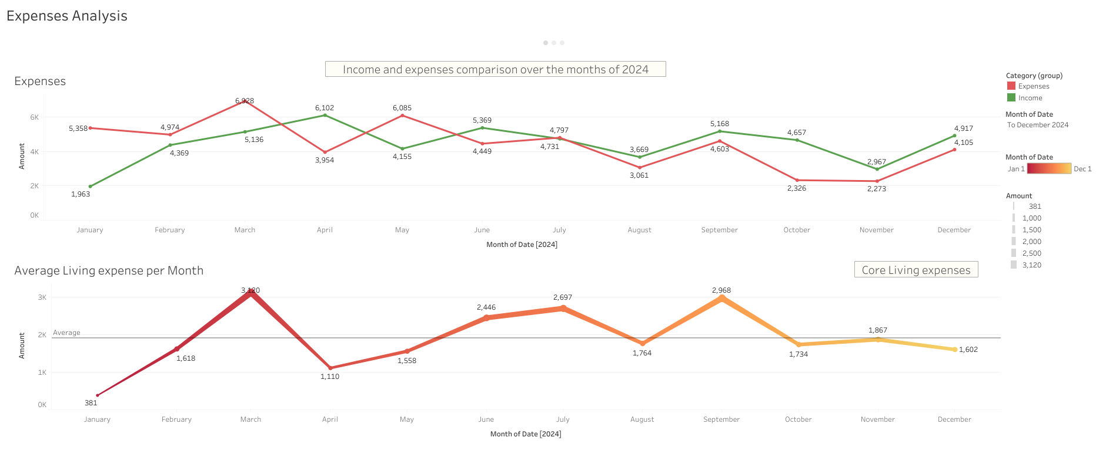

Slide 3
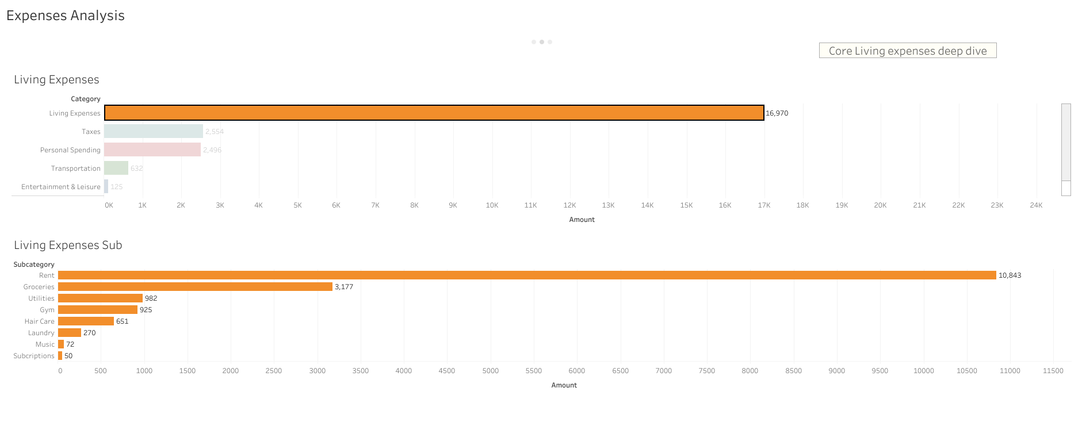

Slide 4
